Slide 1
COMP 2000
Week 7 - Monday

Slide 2
Last time
What did we talk about last time?
Swing menus
Started recursion

Slide 3
Questions?

Slide 4
Project 2

Slide 5
Recursion Examples

Slide 6
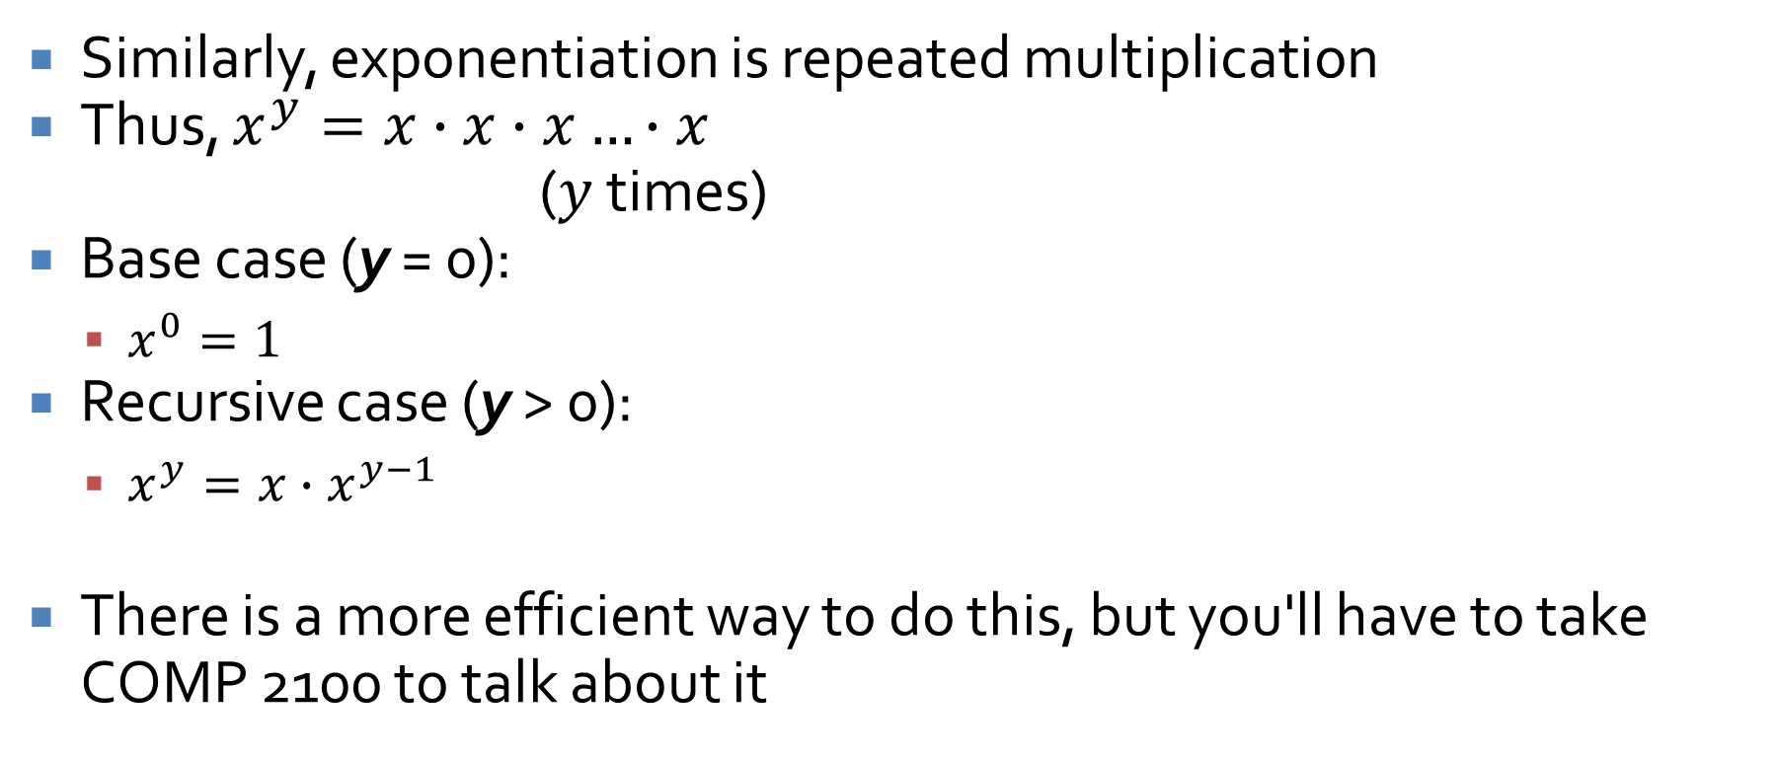
Exponentiation
Similarly, exponentiation is repeated multiplication
Thus, $x^{y}=x∙x∙x…∙x$
($y$ times)
Base case (y = 0):
  $x^{0}=1$
Recursive case (y > 0):
  $x^{y}=x∙x^{y−1}$
There is a more efficient way to do this, but you'll have to take COMP 2100 to talk about it

Slide 7
Code for exponentiation
public static double power( double x, int y ){
if( y == 0 )
return 1.0;
else
return x * power( x, y - 1 );
}
Base Case
Recursive
Case

Slide 8
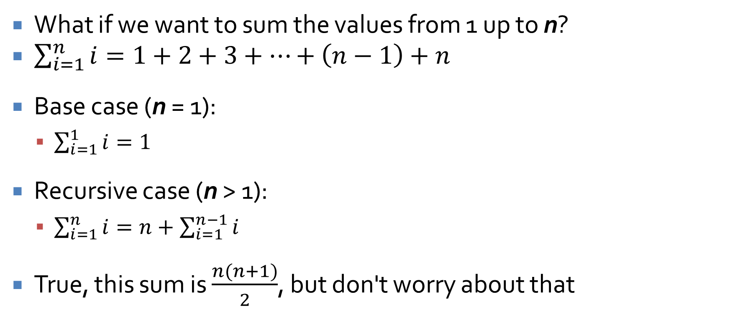
Summing the first n numbers
What if we want to sum the values from 1 up to n?
$\sum_{i=1}^{n}{i}=1+2+3+…+\left(n−1\right)+n$
Base case (n = 1):
  $\sum_{i=1}^{1}{i}=1$
Recursive case (n > 1):
  $\sum_{i=1}^{n}{i}=n+\sum_{i=1}^{n−1}{i}$
True, this sum is $\frac{n(n+1)}{2}$, but don't worry about that

Slide 9
Code for summing up to n
public static int sumUpTo( int n ){
if( n == 1 )
return 1;
else
return n + sumUpTo( n - 1 );
}
Base Case
Recursive
Case

Slide 10
It doesn't have to be mathematical
We could play with strings, too
What if I want to count the number of uppercase or lowercase E's in a string s?
Base case (length(s) = 0):
  eCount(s) = 0
Recursive cases (length(s) > 0):
  If s starts with 'e' or 'E', eCount(s) = 1 + eCount(rest of s)
  Otherwise, eCount(s) = eCount(rest of s)

Slide 11
Code for counting E's
public static int eCount( String s ){
if( s.length() == 0 )
return 0;
else if(s.charAt(0) == 'e' || s.charAt(0) == 'E')
return 1 + eCount(s.substring(1));
else
return eCount(s.substring(1));
}
Base Case
Recursive
Cases

Slide 12
Recursive hints
Always look at the return types
Are you returning the right thing in all cases?
Do you have at least one base case to stop the recursion?
Do you have at least one recursive case to move forward?
Try not to assign variables
Don't use loops (unless explicitly told to)
Don't use member variables or global variables
Don't try to do everything at once!
  Just unwrap one layer…

Slide 13
Recursion Tricks

Slide 14
Comparison to loops
Loops often use indexes to keep track of how far you are in the process
Sometimes that index is used only to determine when a loop is going to terminate
At other times, the index value is needed for work done in the loop
Consider this loop to reverse an array:
for(int i = 0; i < array.length/2; ++i) {
int temp = array[i];
array[i] = array[array.length – i – 1];
array[array.length – i – 1] = temp;
}

Slide 15
Extra information
Recursion sometimes requires similar information that can be passed along to each recursive call
This information could be an index into a String or an array
In graph or tree algorithms, it might be the parent node you visited previously
There are recursive methods with 10 or more parameters
There's nothing wrong with that, provided that you actually need them all

Slide 16
Summing an array
What if we want to sum the values in an array called array?
We need some extra information: current index
Base case (index = length):
  Sum(from index onward):
  0 (Nothing left to sum)
Recursive case (index < length):
  Sum(from index onward):
  array[index] + Sum(from index + 1 onward)

Slide 17
Code for summing an array
public static double sum(double array[], int index) {
if( index == array.length )
return 0.0;
else
return array[index] + sum(array, index + 1);
}
Base Case
Recursive
Case

Slide 18
Reversing a String
What if we want to reverse the contents of a string called s?
We need some extra information: current index
Base case (index = length):
  Reverse(from index onward):
  "" (Nothing left to reverse)
Recursive case (index < length):
  Reverse(from index onward):
  s[length – index - 1] + Reverse(from index + 1 onward)

Slide 19
Code for reversing a String
public static String reverse(String s, int index) {
if( index == s.length() )
return "";
else
return s.charAt(s.length() – index – 1) + reverse(s, index + 1);
}
Base Case
Recursive
Case

Slide 20
Waiting for the recursion to come back
All of the recursion we have shown so far doesn't do much after its recursive call returns
  In actual fact, we have often waited for the return to add, multiply, or concatenate a value
  If we simply returned the result of the previous method, it would be tail recursion
Some recursive methods do significant work before making a recursive call
Some recursive methods do significant work after making a recursive call
Some do both!

Slide 21
Using the stack to go in reverse
All stacks (including the call stack) are first-in last-out (FILO) structures
In situations where we want to deal with things in backwards order, we can use this natural reversing tendency
For example, if we want to print out a String in reverse, we can recurse through each character and print them as the recursion returns
Doesn't make sense yet?

Slide 22
Printing a String in reverse
What if we want to print the contents of a string called s in reverse?
We need some extra information: current index
Base case (index = length):
  ReversePrint(from index onward):
  Print nothing
Recursive case (index < length):
  ReversePrint(from index onward):
  ReversePrint(from index + 1 onward)
  Then print s [index]

Slide 23
Code for printing a String in reverse
public static void reversePrint(String s, int index)
{
if( index < s.length() ) {
reversePrint(s, index + 1); System.out.print(s.charAt(index));
}
}
(Empty) Base Case
Recursive
Case

Slide 24
Reversing a String (the remix)
We can even use this approach to reverse a string in a different manner than we did before
Base case (index = length):
  Backwards(from index onward):
  "" (Nothing left to reverse)
Recursive case (index < length):
  Backwards(from index onward):
  Backwards(from index + 1 onward) + s[index]

Slide 25
Remixed code for reversing a String
public static String backwards(String s, int index) {
if( index == s.length() )
return "";
else
return backwards(s, index + 1) + s.charAt(index);
}
Base Case
Recursive
Case

Slide 26
Mid-Semester Evaluations

Slide 27
Upcoming

Slide 28
Next time…
More recursion

Slide 29
Reminders
Keep reading Chapter 19
Keep working on Project 2
InSocial Risk Advisors are looking for a consultant
  They need help linking together some services with Zapier
  Should be a small amount of work, but it might open up other opportunities
  If interested, send a resume to Jim Waterwash
  Get his contact information from me

